Slide 1
CHAPTER 3
Three Claims; Four Validities: Interrogation Tools for Consumers of Research

Slide 2
Chapter Outline
Variables
Three claims
Interrogating the three claims using the four big validities
Prioritizing validities
Notes:
Here are the major headings in this chapter.
This chapter sets up the framework for the textbook, so it is a very important chapter to understand. The lecture should start with a discussion on what variables are. Then, you should continue with a discussion about the three types of claims (frequency, association, and causal) and the four validities (construct, external, statistical, and internal), and how the validities are prioritized differently depending on what kind of claim is being made.

Slide 3
Variables
Variable versus constant
Measured variable and manipulated variable
From conceptual variable to operational definition
Notes:
Variable: A variable is something that changes or varies, so it needs to have at least two levels or values (but it can have more).
Constant: A constant does not vary. In other words, it stays the same.
Next, we will look at different types of variables:
Measured variables
Manipulated variables
Conceptual variables
Operationalized variables

Slide 4
Measured and Manipulated Variables
A measured variable is observed and recorded.
  Dependent variable (DV)
A manipulated variable is controlled.
  Some variables can only be measured—not manipulated.
  Some variables can be either manipulated or measured
  Independent variable (IV)
Notes:
Researchers either measure or manipulate variables in a study.
Measured variable: Levels are observed and recorded by the researcher. Examples of measured variables include height, IQ, gender, and hair color. Psychologists also measure more abstract variables such as depression and stress.
Manipulated variable: The researcher controls a variable, usually by assigning participants to different levels of that variable. As an example of a manipulated variable, a researcher might assign some people to take a test in a room with many other people and assign others to take the test alone.
Some variables can only be measured—not manipulated:
You cannot assign participants to be a particular age, as age is a naturally occurring variable. Also, sometimes it is unethical to manipulate variables.
For example, in a study on the long-term effects of elementary education, you could not ethically assign children to “high-quality school” and “low-quality school” conditions.
Some variables can be either manipulated or measured:
For example, if childhood extracurricular activities were the variable of interest, you could measure whether children already take music or drama lessons, or you could manipulate this variable by assigning some children to take music lessons and others to take drama lessons.

Slide 5
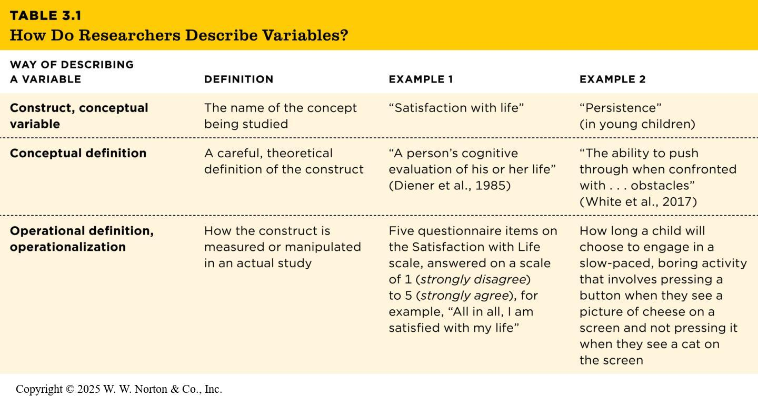
Describing Variables
Notes:
Table 3.1: How Do Researchers Describe Variables?
Conceptual variables and constructs are abstract, theoretical concepts such as “infant temperament” and “anxiety.” I think of them as being “up in the clouds,” but we need to bring them down to the ground from the lofty theoretical level so that we may measure them.
Operational definitions, operational variables, and operationalize: In order to test their hypotheses with empirical data, researchers need to develop operational definitions or operational variables. To operationalize is to turn a conceptual definition into a measured or manipulated variable.
Example: spending time socializing is a conceptual variable, and how often a person spends an evening alone, socializes with friends, and sees relatives in a typical week are operational variables.
Copyright © 2025 W. W. Norton & Co., Inc.

Slide 6
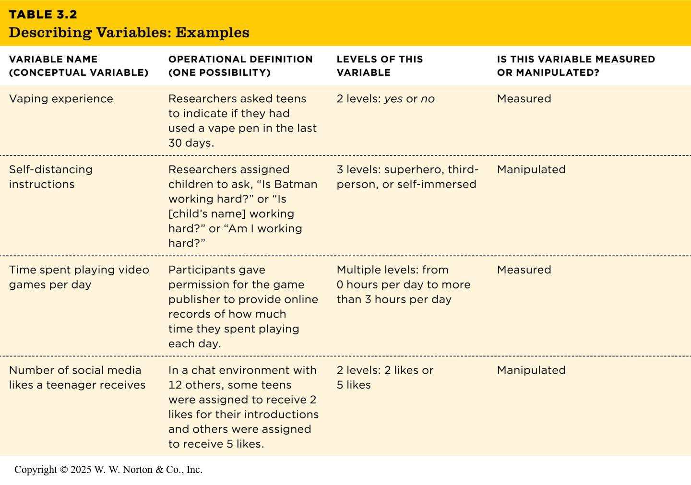
From Conceptual Variables to Operational Definitions: Examples
Notes:
Table 3.2: Describing Variables: Examples
Copyright © 2025 W. W. Norton & Co., Inc.

Slide 7
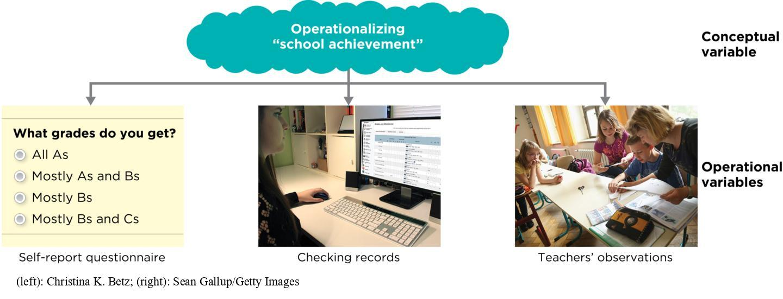
Operationalizing “School Achievement”
Notes:
Figure 3.2: Operationalizing “School Achievement”
A single conceptual variable can be operationalized in a number of ways.
A conceptual variable can be operationalized in different ways.
The conceptual level is “school achievement.”
Operational definitions can include administering self-report questionnaires, checking records, and obtaining teachers’ observations.
(left): Christina K. Betz; (right): Sean Gallup/Getty Images

Slide 8
Three Claims
Frequency claims
Association claims
Causal claims
Not all based on research
Notes:
Table 3.3: Examples of Each Type of Claim
Claim: An argument someone is trying to make. Psychological scientists use data to test and refine theories and claims.
Frequency claim: one variable
Association claim: two variables that are related
Causal claim: two variables, one of which causes the other

Slide 9
Frequency Claims
A frequency claim describes a particular level or degree of a single variable.
Frequency claims involve only one measured variable.
Notes:
Examples:
21% of Canadian adolescents ages 15–17 reported vaping in the last month
The global average life expectancy is 73 years about six in ten black adults say racism is an extremely big problem for black people in the U.S. Today
20% believe the COVID-19 vaccine contains a microchip
Few transgender children change their minds after 5 years, study finds

Slide 10
Association Claims
An association claim argues that one level of a variable is likely to be associated with a particular level of another variable.
Association claims are supported by studies that have at least two measured variables.
Variables that are associated are said to correlate.
Notes:
Association claim: One level of a variable is likely to be associated with a particular level of another variable.
Examples:
Regular coffee consumption associated with lower depression risk
Playing an instrument is linked to better cognition
Parents attached to digital devices are more likely to yell at their kids
Gaming time has no link to well-being, study finds
Correlate: Variables covary, meaning they are related; as one variable changes, the other tends to change too. A study in which the variables are measured and the relationship between them is tested is called a correlational study.
Three basic types of associations:
Positive
Negative
Zero

Slide 11
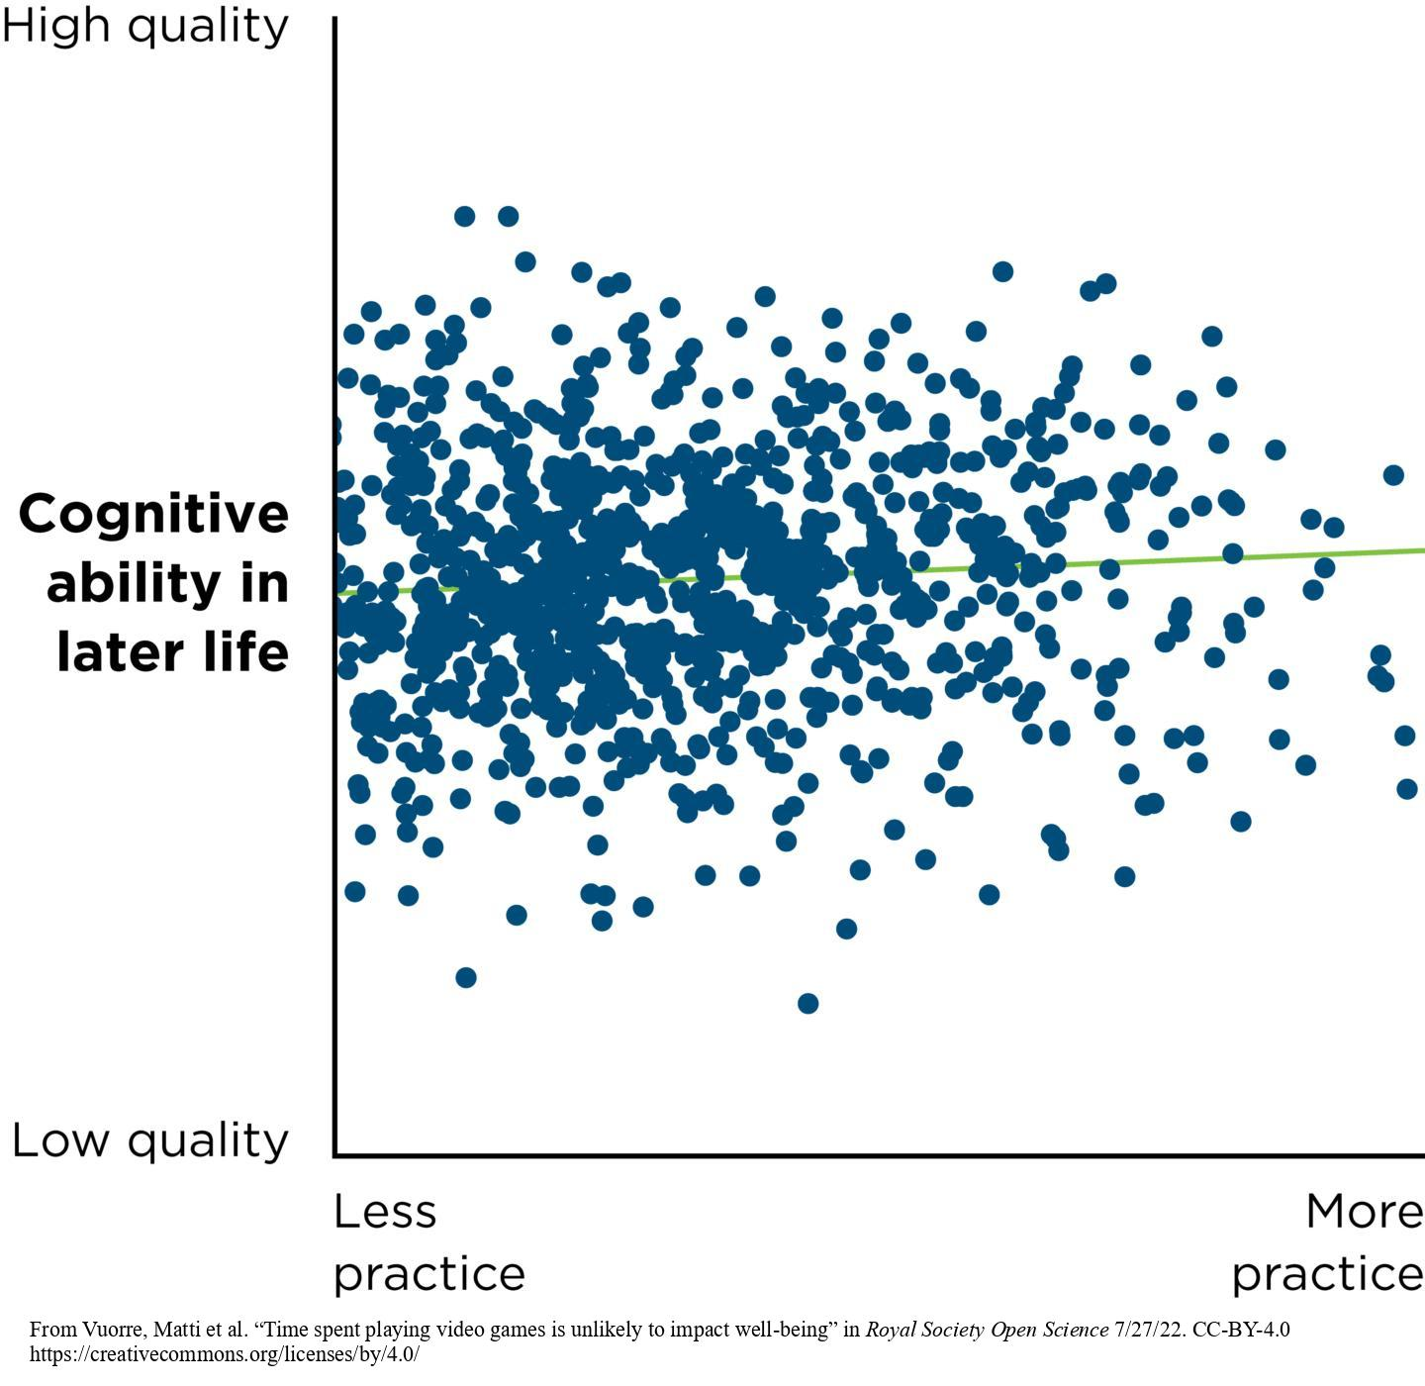
Positive Association
Notes:
Figure 3.3A: Scatterplot Showing Positive Association
(A) Positive association: “Playing an instrument is linked to better cognition.” (Data are fabricated but based on Okely et al., 2022.)
Positive association (also known as positive correlation): High scores on one variable are associated with high scores on another variable or low scores on one variable are associated with low scores on another variable.
Example (see the figure):
“Playing an instrument is linked to better cognition.” (Data are fabricated but based on Okely et al., 2022.)
Scatterplot: One way to represent an association is to plot one variable on the x-axis and the other variable on the y-axis
The slope of a positive association goes up as you move from left to right.
From Vuorre, Matti et al. “Time spent playing video games is unlikely to impact well-being” in Royal Society Open Science 7/27/22. CC-BY-4.0 https://creativecommons.org/licenses/by/4.0/

Slide 12
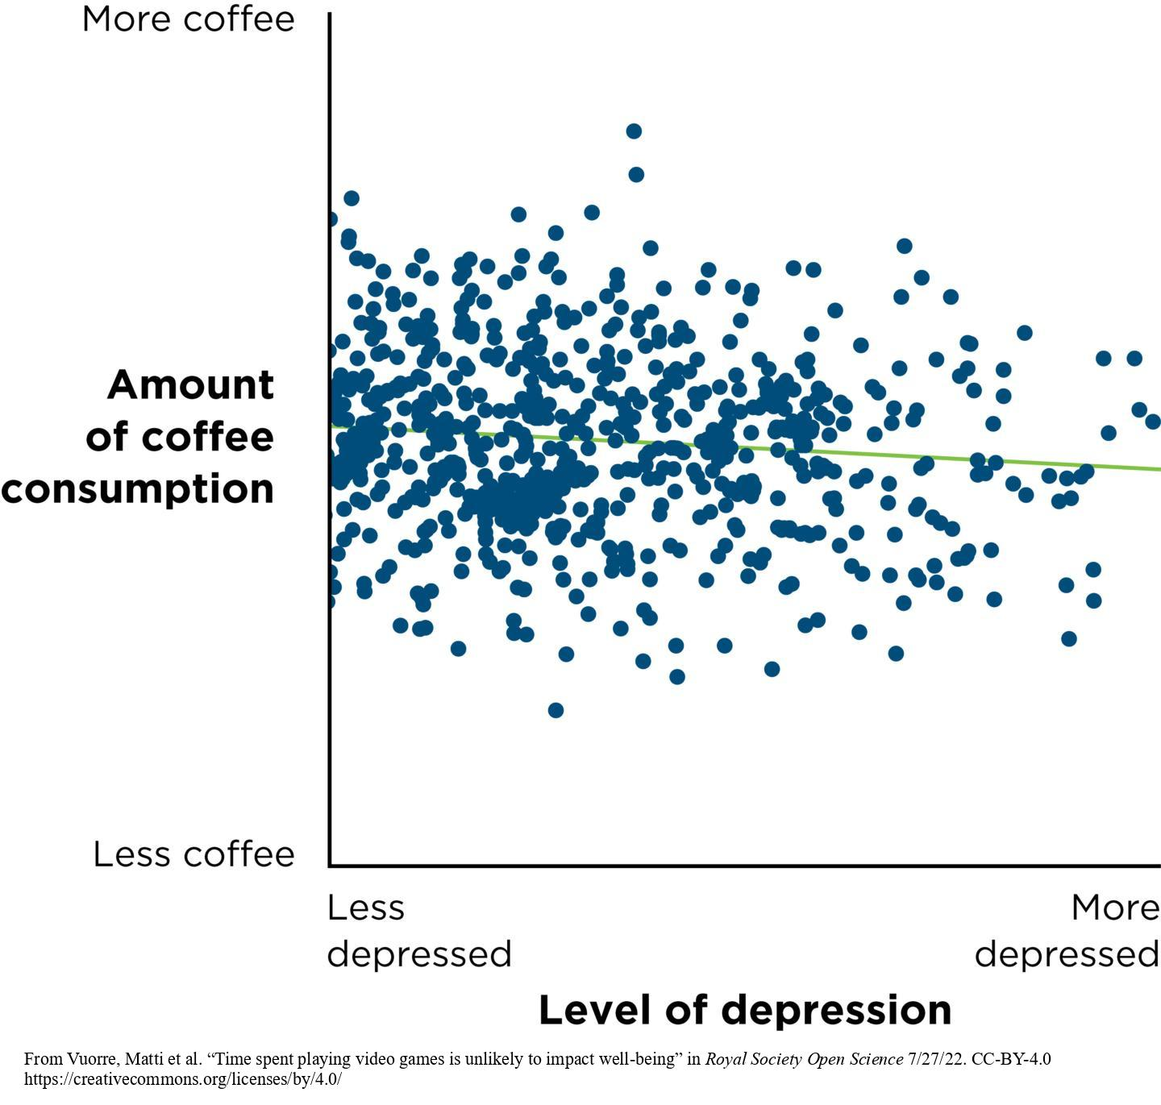
Negative Association
Notes:
Figure 3.3B: Scatterplot Showing Negative Association
(B) Negative association: “Regular coffee consumption associated with lower depression risk.” (Data are fabricated but based on Wang et al., 2015.)
The figure depicts a scatterplot showing negative association (also known as inverse association or negative correlation): High scores on one variable are associated with low scores on another variable or low scores on one variable associated with high scores on another variable.
Example: “Regular coffee consumption associated with lower depression risk.” (Data are fabricated but based on Wang et al., 2015.)
Describe the negative slope, which decreases as you move from left to right across the scatterplot.
From Vuorre, Matti et al. “Time spent playing video games is unlikely to impact well-being” in Royal Society Open Science 7/27/22. CC-BY-4.0 https://creativecommons.org/licenses/by/4.0/

Slide 13
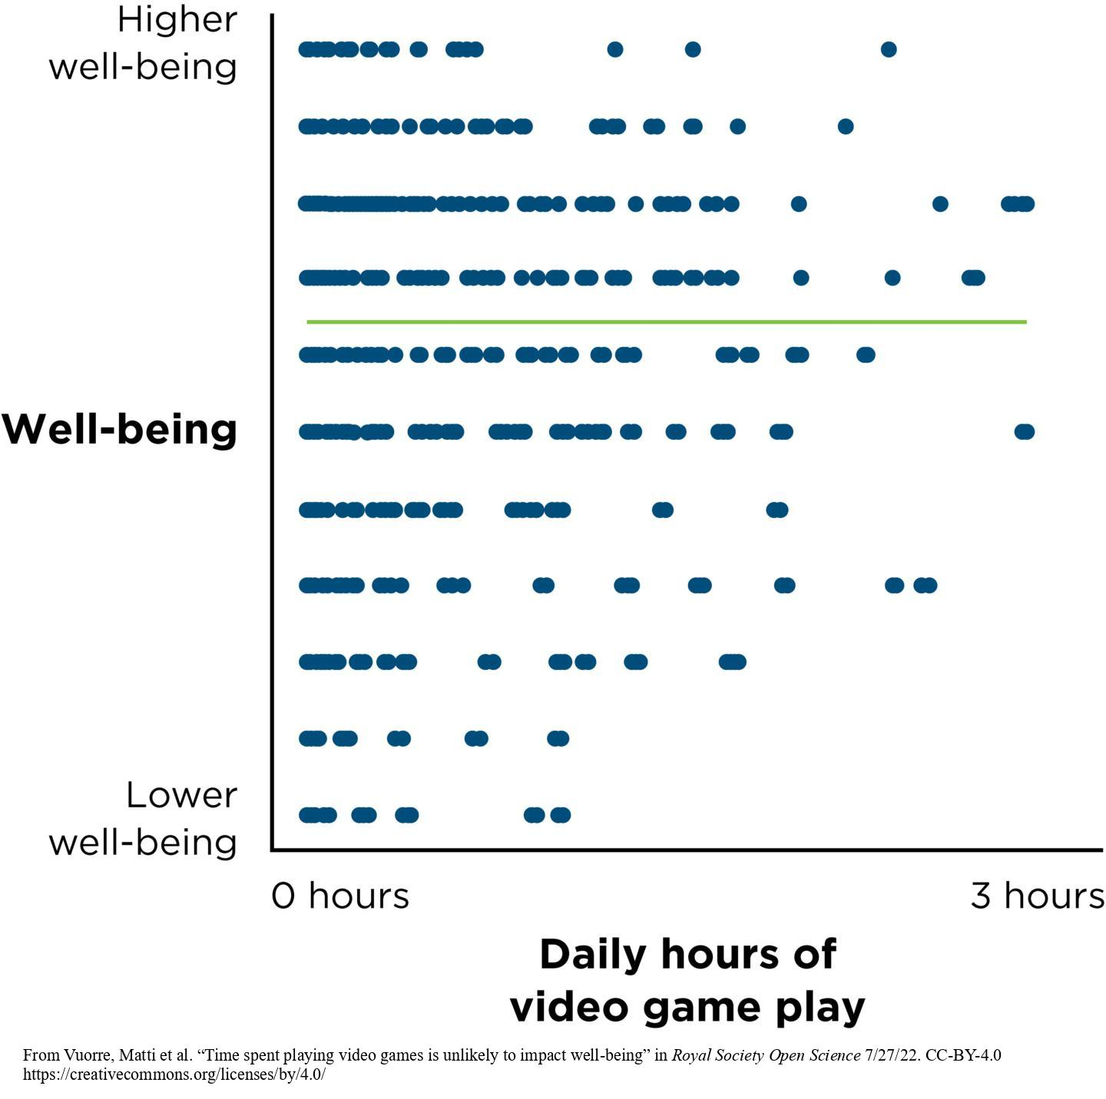
Zero Association
Notes:
Figure 3.3C: Scatterplot Showing Zero Association
(C) Zero association: “Gaming time has no link to wellbeing, study finds.” (Data are from Vuorre et al., 2022.)
The figure depicts a scatterplot showing zero association (also known as zero correlation): There is no association between variables.
Example: “Gaming time has no link to well-being, study finds.” (Data are from Vuorre et al., 2022.)
Describe the cloud of points that results.
From Vuorre, Matti et al. “Time spent playing video games is unlikely to impact well-being” in Royal Society Open Science 7/27/22. CC-BY-4.0 https://creativecommons.org/licenses/by/4.0/

Slide 14
Making Predictions Based on Associations
Some association claims are useful because they help us make predictions.
The stronger the association between the two variables, the more accurate the prediction will be.
Both positive and negative associations can help us make predictions, but zero associations cannot.
Notes:
Some association claims are useful because they help us make predictions.
Prediction involves using the association to make our estimates more accurate; it does not necessarily mean we can know what will happen in the future.
The stronger the association between the two variables, the more accurate the prediction will be, and the weaker the relationship, the less accurate the prediction will be.
Both positive and negative associations can help us make predictions, but zero associations cannot.

Slide 15
Causal Claims
A causal claim argues that one variable causes changes in the level of another variable.
Causal claims are supported by experiments (studies that have a manipulated variable (IV) and a measured variable (DV).)
Notes:
Examples:
Baby’s superpowered scent can affect parents’ moods, researchers find
Talking to strangers might make you happier
Logic’s song 1-800-273-8255 may have led to hundreds of fewer suicides
Pretending to be Batman helps kids stay on task
To appear more intimidating, just tilt your head down, study suggests
Family meals curb teen eating disorders

Slide 16
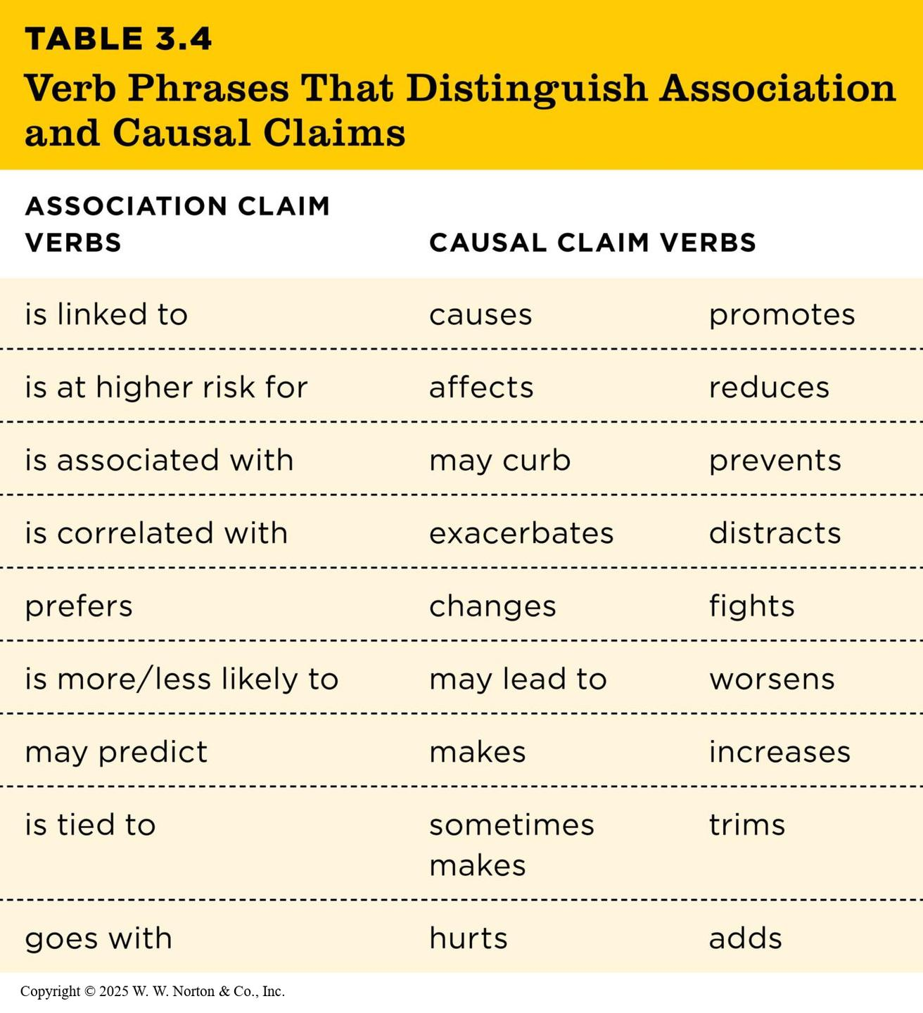
Verbs for Causal Claims
Table 3.4
TABLE 3.4 Verb Phrases That Distinguish Association and Causal Claims
ASSOCIATION CLAIM VERBS | CAUSAL CLAIM VERBS
is linked to | causes | promotes
is at higher risk for | affects | reduces
is associated with | may curb | prevents
is correlated with | exacerbates | distracts
prefers | changes | fights
is more/less likely to | may lead to | worsens
may predict | makes | increases
is tied to | sometimes makes | trims
goes with | hurts | adds
Notes:
Table 3.4: Verb Phrases That Distinguish Association and Causal Claims
Causal claim: One of the variables is responsible for changing the other; there is one measured variable and one manipulated variable. Like an association claim, the two variables covary.
Example: Music lessons enhance IQ.
Verbs for casual claims:
affects
leads to
reduces
Verbs for association claims:
is associated with
is related to
is linked to
A causal claim that contains tentative language (could, may, seem, suggest) is still a causal claim.
Example: Music lessons may enhance IQ.
Copyright © 2025 W. W. Norton & Co., Inc.

Slide 17
Not All Claims Are Based on Research
Not all claims we read about in the popular press are based on research.
Some claims are based on experience, intuition, or authority.
Notes:
As discussed in Chapter 2, there are other ways of knowing besides research (e.g., experience, intuition, authority). Not all claims that we see, hear, or read about in the popular media are based on research.
Examples:
Paranoia, voices, sleeplessness: What my psychotic break felt like for some teens, as masks come off, anxiety sets in
Octopuses caught on camera throwing junk at each other during underwater fights
For some with ADHD, the low rumble of brown noise quiets the brain

Slide 18
Interrogating the Three Claims Using the Four Big Validities
Interrogating frequency claims
Interrogating association claims
Interrogating causal claims
Prioritizing validities
Notes:
Valid: reasonable, accurate, and justifiable; validity is the appropriateness of a conclusion or decision.

Slide 19
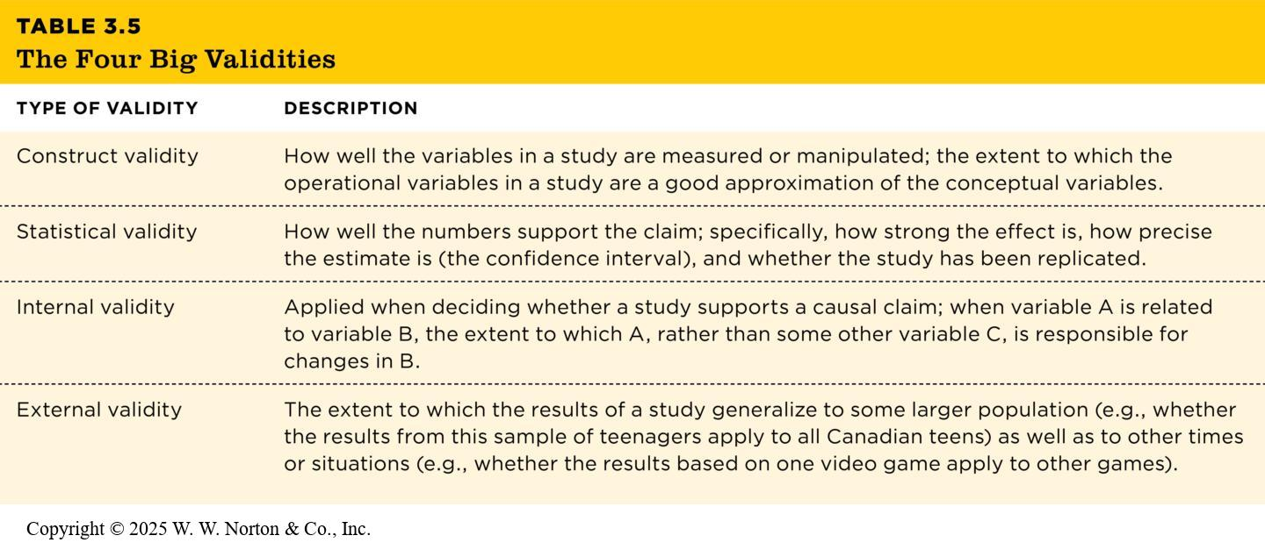
The Four Big Validities
Table 3.5
TABLE 3.5 The Four Big Validities
TYPE OF VALIDITY | DESCRIPTION
Construct validity | How well the variables in a study are measured or manipulated; the extent to which the operational variables in a study are a good approximation of the conceptual variables.
Statistical validity | How well the numbers support the claim; specifically, how strong the effect is, how precise the estimate is (the confidence interval), and whether the study has been replicated.
Internal validity | Applied when deciding whether a study supports a causal claim; when variable A is related to variable B, the extent to which A, rather than some other variable C, is responsible for changes in B.
External validity | The extent to which the results of a study generalize to some larger population (e.g., whether the results from this sample of teenagers apply to all Canadian teens) as well as to other times or situations (e.g., whether the results based on one video game apply to other games).
Notes:
Table 3.5: The Four Big Validities
Introduce the four big validities in general before describing how they are interrogated for the three different types of claims.
Copyright © 2025 W. W. Norton & Co., Inc.

Slide 20
Interrogating Frequency Claims
Construct validity
External validity, or generalizability
Statistical validity
Notes:
When interrogating frequency claims, we will want to focus on construct validity and external validity. Statistical validity may be relevant as well.
Construct validity: How well a conceptual variable is operationalized. Example: 39% of teens text while driving.
How was depression operationally defined?
External validity (also known as generalizability): How well the results of a study represent the people or contexts besides those in the study itself. Example: 73% of the world laughed yesterday.
Which people did they survey, and how did they choose their participants? Did they include only people in major urban areas? Did they ask only college students from each country? Or did they attempt to randomly select people from every region of the world?
Statistical validity (also known as statistical conclusion validity): The extent to which the study’s conclusions are reasonable and accurate.
Point estimate: A single estimate of some population value (such as a percentage, a correlation, or a difference) based on data from a sample.
Confidence Interval (CI): A given range indicated by a lower and upper value that is designed to capture the population value for some point estimate (e.g., percentage, difference, or correlation); a high proportion of CIs will capture the true population value.
Margin of Error: In the context of a percentage estimate, an inferential statistic providing a range of values that has a high probability of containing the true population value. Example: In the report about how many teenagers text while driving, the Centers for Disease Control’s finding of a 39% value was accompanied by the confidence interval, 37.0–41.4.

Slide 21
Interrogating Association Claims
Construct validity
External validity
Statistical validity
Notes:
A reminder: Association claims involve the relationship between two measured variables, so we must interrogate construct, external, and statistical validities.
Construct validity: similar to construct validity for a frequency claim except that now there are two conceptual variables that need to be operationalized appropriately.
Example: “Regular Coffee Consumption Associated with Lower Depression Risk”
How well were the two variables measured?
External validity: Does the association claim generalize to other populations, contexts, times, or places?
Example: For the association between coffee consumption and depression,
Would the association generalize to men?
Would it generalize to other forms of caffeine?
Statistical validity: When referring to an association claim, statistical validity is the extent to which the statistical conclusions are accurate and reasonable. There are two aspects of statistical validity to consider: strength and statistical significance. As with frequency claims, the estimate of an association may be accompanied by a confidence interval.

Slide 22
Interrogating the Three Types of Claims Using the Four Big Validities
TABLE 3.6 Interrogating the Three Types of Claims Using the Four Big Validities
TYPE OF VALIDITY | FREQUENCY CLAIMS (“ALMOST 3/4 OF THE WORLD LAUGHED YESTERDAY”) | ASSOCIATION CLAIMS (“PLAYING AN INSTRUMENT IS LINKED TO BETTER COGNITION”) | CAUSAL CLAIMS (“PRETENDING TO BE BATMAN HELPS KIDS STAY ON TASK”)
 | Usually based on a survey or poll but can come from other types of studies | Usually supported by a correlational study | Must be supported by an experimental study
Construct validity | How well have researchers measured the variable in question? | How well have researchers measured each of the two variables in the association? | How well have researchers measured or manipulated the variables in the study?
Statistical validity | What is the point estimate? What is the confidence interval (margin of error) of the estimate? Are there other estimates of the same percentage? | What is the estimated effect size: How strong is the association? How precise is the estimate: What is the confidence interval? Has it been replicated? | What is the estimated effect size: How large is the difference between groups? How precise is the estimate: What is the confidence interval? Has it been replicated?
Internal validity | Frequency claims do not usually assert causality, so internal validity is not relevant. | People who make association claims are not asserting causality, so internal validity is not relevant. However, a writer should avoid making a causal claim from a simple association (see Chapter 8). | Was the study an experiment? Does the study achieve temporal precedence? Does the study control for alternative explanations by randomly assigning participants to groups? Does the study avoid internal validity threats? (See Chapters 10 and 11.)
External validity | To what populations, settings, and times can we generalize this estimate? How representative is the sample? Was it a random sample? | To what populations, settings, and times can we generalize this association claim? How representative is the sample? To what other situations might the association be generalized? | To what populations, settings, and times can we generalize this causal claim? How representative is the sample? How representative are the manipulations and measures?
Notes:
Table 3.6: Interrogating the Threes Types of Claim Using the Four Big Validities
This table is a summary of how we interrogate the three claims (frequency, association, and causal) using the four big validities (construct, statistical, internal, and external).
Copyright © 2025 W. W. Norton & Co., Inc.

Slide 23
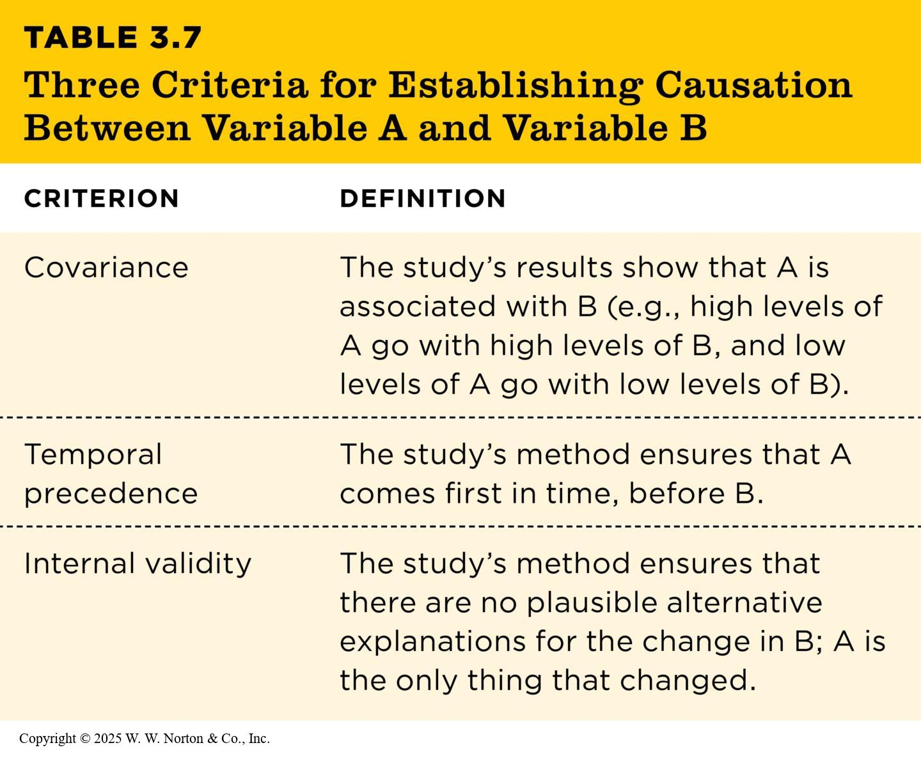
Interrogating Causal Claims
Table 3.7
TABLE 3.7 Three Criteria for Establishing Causation Between Variable A and Variable B
CRITERION | DEFINITION
Covariance | The study’s results show that A is associated with B (e.g., high levels of A go with high levels of B, and low levels of A go with low levels of B).
Temporal precedence | The study’s method ensures that A comes first in time, before B.
Internal validity | The study’s method ensures that there are no plausible alternative explanations for the change in B; A is the only thing that changed.
Notes:
Table 3.7: Three Criteria for Establishing Causation Between Variable A and Variable B
Because causal claims state that one variable causes another variable, they use directional verbs like leads to, affects, and influences.
There are three criteria for causation:
1. Covariance: This simply means that the two variables are related. Association claims fulfill this criterion.
2. Temporal precedence: One variable comes before the other variable in time. Because the researcher is manipulating one variable and then measuring the other variable, she knows the manipulated variable comes before the outcome variable, which is measured after the manipulation.
3. Internal validity (also known as the third-variable criterion): a study should be able to eliminate alternative explanations. In other words, Variable A is the only thing that changed.
Copyright © 2025 W. W. Norton & Co., Inc.

Slide 24
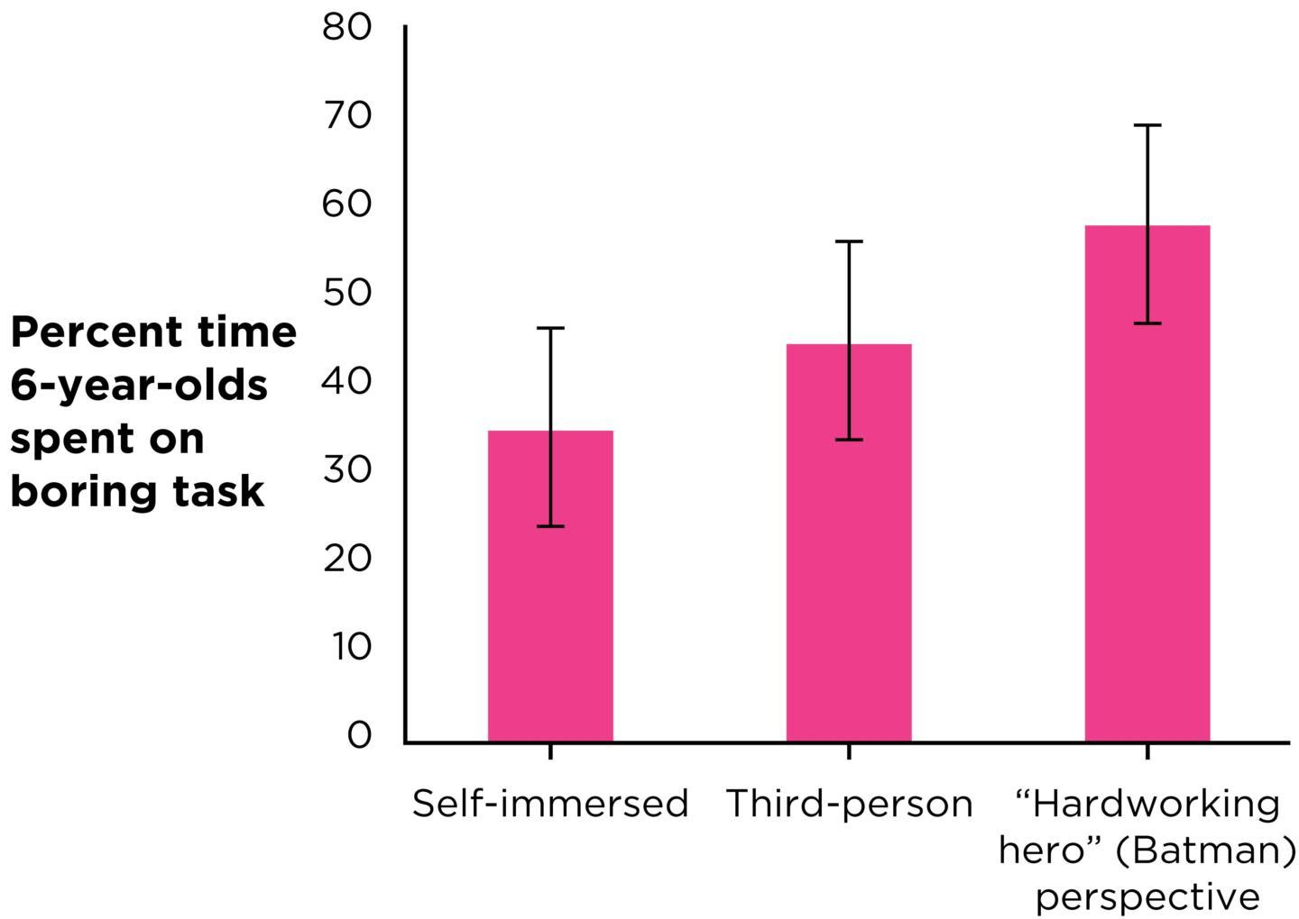
Experiments Can Support Causal Claims
Experiment
Independent variable
Dependent variable
Random assignment
Notes:
Figure 3.5: Interrogating a Causal Claim
What features of White et al.’s study made it possible to support the causal claim that pretending to be Batman causes kids to persist longer at a boring task? (The error bars represent the standard error of the estimate. Source: White et al., 2017.)
In order to support a causal claim, a researcher needs to conduct an experiment in which one variable is manipulated and the other is measured.
Independent variable: manipulated or variable (cause) in an experiment (e.g., type of lessons; four levels: keyboard, voice, drama, no lessons)
Dependent variable: measured variable (effect) in an experiment (e.g., IQ)
Random assignment: a method of assigning participants to levels of the independent variable such that each group is as similar as possible; flipping a coin or rolling a die; increases internal validity by controlling for potential alternative explanations
Republished with permission of The Society for Research in Child Development, Blackwell Publishing, Inc, John Wiley & Sons, from “The ‘Batman Effect’: Improving Perseverance in Young Children,” in Child Development, Rachel E. White, Emily O. Prager, Catherine Schaefer, Ethan Kross, Angela L. Duckworth, Stephanie M., Vol 88, Issue 5, pp. 1563–1571, © 2016; permission conveyed through Copyright Clearance Center, Inc.

Slide 25
When Causal Claims Are a Mistake
Does eating meals as a family really curb eating disorders?
Does social media pressure cause teen anxiety?
Notes:
Figure 3.7: Support for a Causal Claim?
Without conducting an experiment, researchers cannot support the claim that social media use affects teens’ mental health.
Sometimes an article in the popular press may sound like it’s a causal claim when really it’s not. Here are two examples:
Do family meals really curb eating disorders?
Covariance: Yes, there is an association between family meals and eating disorders.
Temporal precedence: Did the family meals increase before the eating disorders decreased? It’s not clear.
Internal validity: No. We can’t rule out third-variable explanations without an experiment.
Other possible explanations: (1) Perhaps girls from single-­parent families are less likely to eat with their families and are vulnerable to eating disorders, whereas girls who live with both parents are not. (2) Maybe high-achieving girls are too busy to eat with their families and are also more susceptible to eating-­disordered behavior.
Does Social Media Use Harm Adolescents?
Covariance: Yes. The results showed a relationship between social media use and mental health outcomes.
Temporal precedence: No. The study was correlational, measuring social media use and mental health outcomes simultaneously, making it unclear whether social media use caused mental health issues or vice versa.
Internal validity: No. Since it was not an experimental study, potential confounding factors (e.g., preexisting mental health conditions, offline stressors) were not controlled, leaving alternative explanations for the observed relationship unresolved.
Joshua Resnick/Shutterstock

Slide 26
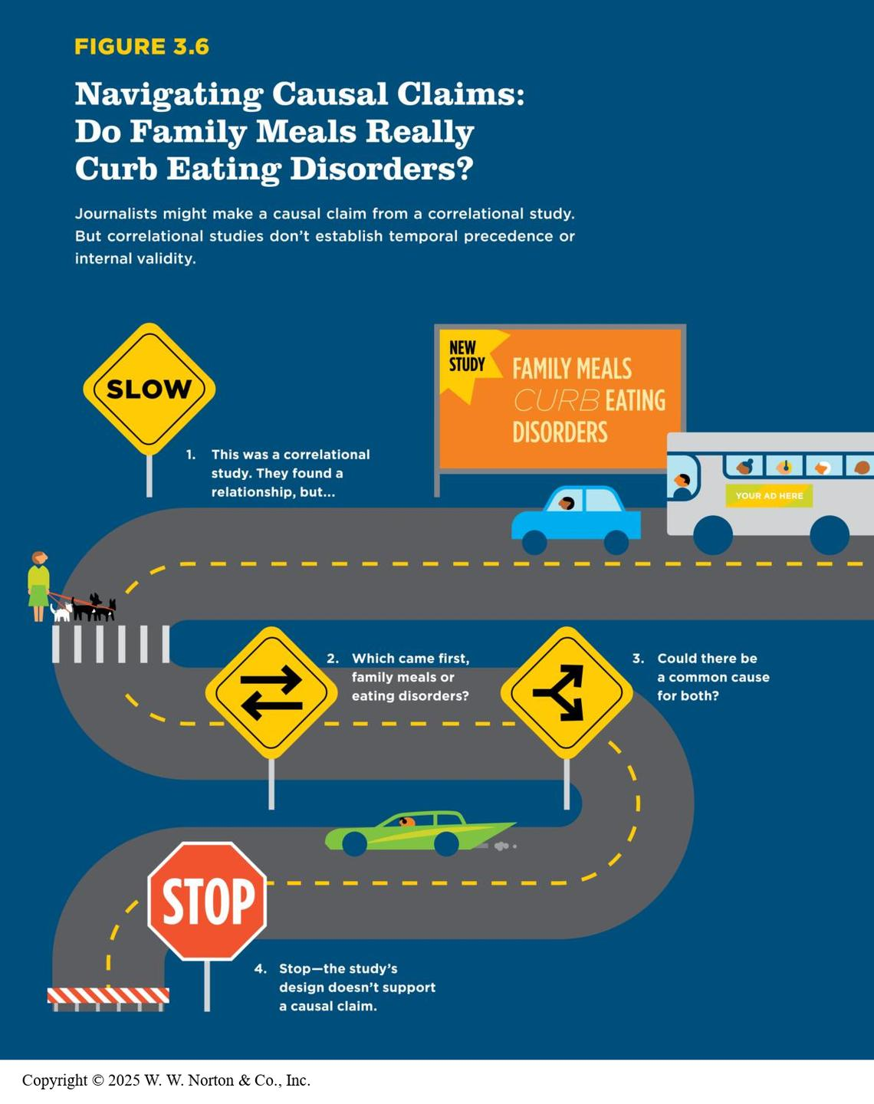
Navigating Causal Claims
Notes:
Figure 3.6: Navigating Causal Claims: Do Family Meals Really Curb Eating Disorders?
Journalists might make a causal claim from a correlational study. But correlational studies don’t establish temporal precedence or internal validity.
Copyright © 2025 W. W. Norton & Co., Inc.

Slide 27
Other Validities to Interrogate in Causal Claims
Construct validity
External validity
Statistical validity
Notes:
We have been emphasizing internal validity because it is only important when interrogating causal claims. However, we still need to consider the three other types of validity:
Construct validity: This is always important regardless of what kind of claim you’re making; you need to consider the construct validity of both the manipulated variable and the measured variable.
External validity: Do the results generalize to other people or contexts? This probably isn’t paramount since internal validity tends to be emphasized in experiments, and internal and external validity are kind of like two sides of a coin. As internal validity increases, external validity decreases, and vice versa.
Statistical validity: How strong is the relationship between the independent variable and the dependent variable? Is the difference between groups statistically significant?

Slide 28
Prioritizing Validities
Which of the four validities is the most important?
It depends on what kind of claim the researcher is making and the researcher’s priorities.
Notes:
It’s impossible to find a study that satisfies all four validities at once. This means that researchers must decide on their priorities according to the goals of the study.
Example: Internal validity is typically a top priority when making causal claims but not when making frequency or association claims.

